Slide 1
ACCESSIBILITY EVALUATION: UEQ PRINCIPLES IN USER INTERFACE DESIGN FOR PERSONS WITH DYSLEXIA AND COLOR BLINDNESS
Student: Aytan Gurbanova
Advisor: Dr. Stephen Kaisler
Date: 30.04.2024

Slide 2
Outline
Introduction
Methodolody and Technical Approach
Evaluation Process
Evaluation Results
Conclusion and Future Work

Slide 3
Introduction
Accessibility for All: Technology should be usable by everyone, no matter their circumstances.
Focus on Dyslexia and Color Blindness: Enhancing accessibility for individuals with dyslexia and color blindness.
Creating Evaluation Metrics: Creating evaluation criteria based on the UEQ principles.
Improving Usability: Following accessibility guidelines can significantly improve accessibility.
Project Repo: https://github.com/aytan-gurbanova/Master-Thesis

Slide 4
Methodolody and Technical Approach
Introduction to UEQ:
Measures user feelings about product UX
Uses opposite-meaning words and 7-point scale
Application of UEQ Principles:
Used in post-testing interviews
Interviewed 9 users from dyslexia, color blindness, and neither groups
Users shared thoughts on evaluation process and design
Introduction to "HNK Bank" App:
Mobile banking app
Designed for dyslexia and color blindness
Features: "transfer," "text-to-speech," "edit profile," "help" screen

Slide 5
Evaluation Process
Testing Scenarios:
Four scenarios designed for user testing
Scenario 1: Create a New Account and Review Cards
Scenario 2: Existing User Dashboard Orientation
Scenario 3: Existing User Preference Settings
Scenario 4: Existing User Money Transfer
Scenarios simulate real-life situations
Testing Process:
No intervention during testing
Time recorded for each scenario
Interviews conducted after evaluation
Interview Structure:
10-question interview
8 Likert-scale questions covering accessibility features
Focus on text readability, color contrast, font choices, etc.
Final question open-ended for user feedback and suggestions

Slide 6
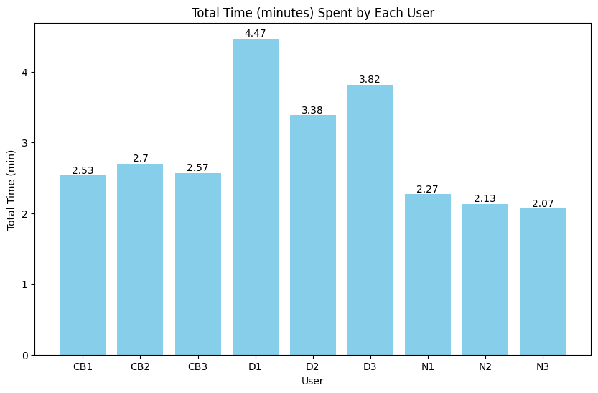
Evaluation Results: Time Spent by Each User
Dyslexic people took longer to finish tasks and had more time variations.
People without color blindness or dyslexia finished tasks quickly, similar to those with color blindness.
Using the right colors, as mentioned in interviews, helped everyone finish tasks well, regardless of disabilities.

Slide 7
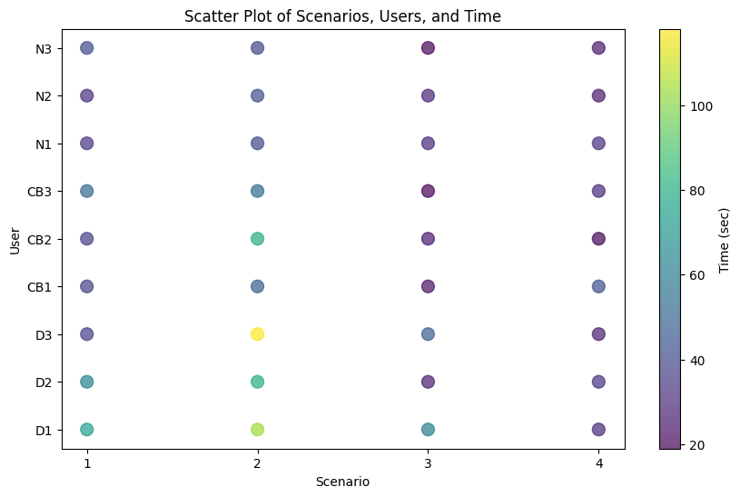
Evaluation Results: Scatter Plot of Scenarios, Users, and Time
Scenario 4 (money transfer) was the fastest; Scenario 2 (dashboard walkthrough) took the longest.
Dyslexic users took much longer to review the dashboard.
Only users without dyslexia or color blindness completed all scenarios in under a minute.

Slide 8
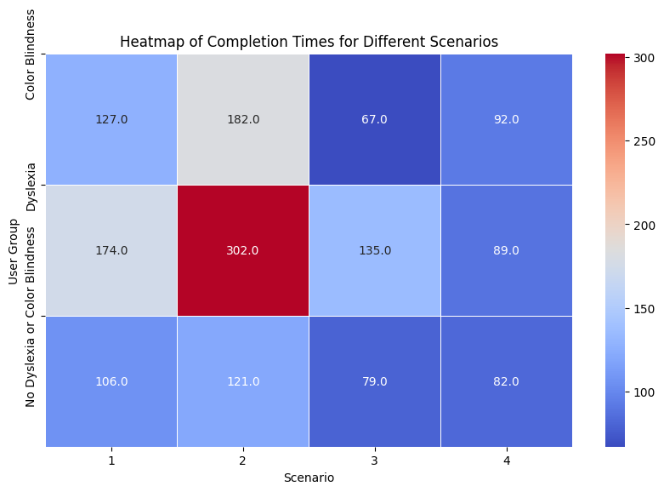
Evaluation Results: Heatmap of Total Completion Times for Different Scenarios
The Color Blindness group finished the third scenario quickest, taking only 67 seconds.
Dyslexic individuals took the longest to complete the second scenario.
Dyslexic individuals were slowest in the first three scenarios, while the Color Blindness group was slowest in the fourth.

Slide 9
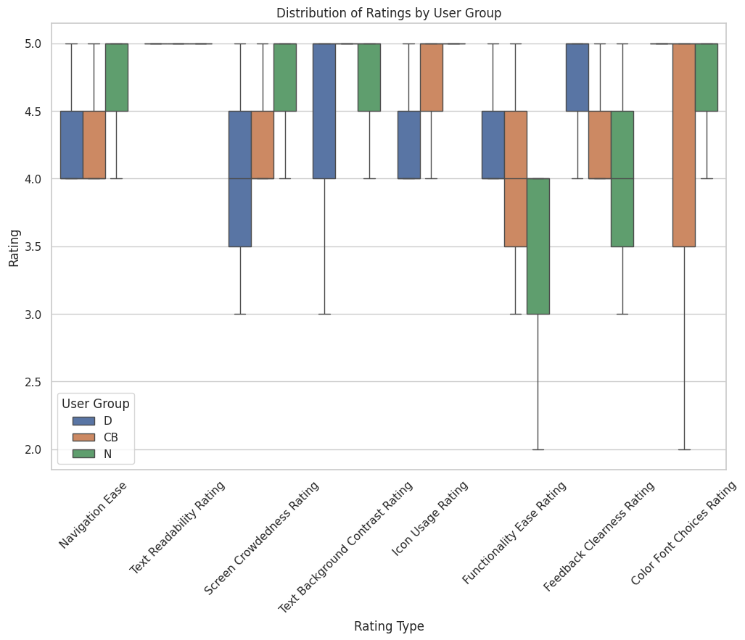
Evaluation Results: Ratings Distribution by User Group
Created from post-interview data.
All users rated text readability as 5.
The lowest rating (2) was for functionality ease and color font choices.
Most ratings were above 4 on average, with a few ratings of 3 or 2.
Participants from all groups agreed on a low rating (averaging 3.8) for functionality ease.

Slide 10
Evaluation Results: User Likes and Suggestions
User Group | Likes | Suggestions
D | The font selection | Add a card scan option in the money transfer. Implement template creation to reduce repetition. Shorten texts in the “help” screen. Add buttons/links that redirect to described actions. Consider adding more functionalities.
CB | The color choices | Provide more informative feedback messages. Add the ability to copy card details. Offer more background color options.
N |  | Increase spacing between sections. Add speech-to-text functionality and the option to choose a card in "transfer", and more options in "edit profile" such as profile picture.
Intersection | The simplicity of the application and the text-to-speech function | Add a language option with Azerbaijani.

Slide 11
Conclusion and Future Work
All users liked the application and find it easy to use.
Users didn't face major issues with reading and understanding the app.
All participants suggested adding Azerbaijani language support.
Although users liked the app's simplicity, there's a need to add more features.
As the app becomes more complex, accessibility may decrease, so future updates should balance complexity and accessibility.
Support for users with visual or hearing impairments should be enhanced, possibly by improving the text-to-speech feature and adding speech-to-text functionality to make the app accessible to all users.

Slide 12
Thank you for your attention

